Slide 1
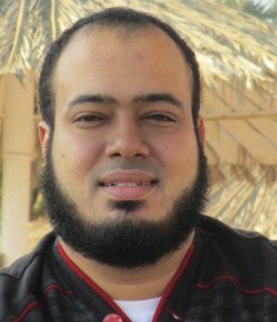
Competitive Programming From Problem 2 Solution in O(1)
P
T
H
I
N
K
F
A
S
T
S
C++ Data Types and Variables
Mostafa Saad Ibrahim
Teaching Assistant @ Cairo University

Slide 2
Remember
Magical Fact:
Read little + Practice much => Write good
Knowledge will be weird in the begin
Keep trying…read weird things again
Don’t be depressed. Challenge yourself

Slide 3
Suggested Books
A First Book C++
C++ Primer

Slide 4
Data Types
Say we want to computer program sums numbers from 50 to 90
We need to pass from 50 to 90 and sum numbers: 50+51+52+….90
So sum initially is 50. In second step = 101. In 3rd step = 153 and so on.
Where to save this updated sum?

Slide 5
Data Types
Our computers has memory (RAMs)
Memory has size (e.g. 256 M) & stores 0s &1s
We use this memory to store our computed data
What types of data that we need to save?

Slide 6
Data Types
We need to save discrete numbers (integer)
And fractions 3.14 (float)
What about decisions? True& False
What about Blood type B? Character
What about a name? Sequence of characters

Slide 7
C++ Data Types
C++ Supports Built in data types
Integral Data Types
Signed (allow negative) or unsigned (no negative)
Floating Point Data types
Void (no value)
C++ allows you create your types
Structure / Class

Slide 8
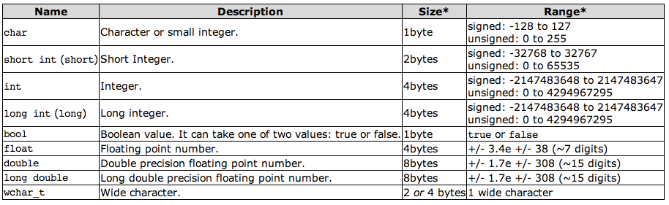

Data Types Details
Notes:
Img Src : http://www.openframeworks.cc/tutorials/introduction/images/variable-types.png
Src: http://www.cplusplus.com/articles/DE18T05o/

Slide 9
Variables
Data in memory has addresses (in range RAM size) and types (e.g. integer)
It is not convenient to refer to physical address
Variable = give name to location in memory
Variable = named storage to a data type stored in RAM

Slide 10
Variables Declaration Examples
Integral Types
short x = 50;
int y = 10;
long long z = 9223372036854775807
char letter = ‘B’;
bool status = true;
int t; => Contains garbage
Floating Point Types
float f1 = 3.14;
double salary = 1500.6;

Slide 11
Investigating variable statement
int sum = 255;
int = integer variable type = 4 bytes in RAM
sum = variable name (called identifier)
Memory value = 255 (called literal)
In binary format:255= 00000000000000000000000011111111
In hexadecimal format:255= 000000FF
; end of statement
Reserve variable address in memory: 90E0100D

Slide 12
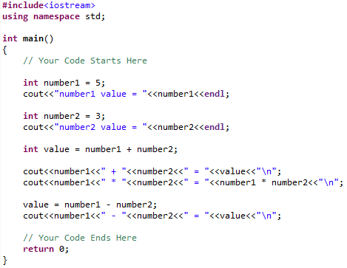

Usage Examples
Declaration
initialization
Assignment. Don’t declare again

Slide 13
Identifier (variable name)
Identifier: Variable name
int sum = 10; => sum is identifier
Identifier consist of: letters, digits, _
iNumber, status1, status2, mostafa_saad, _valid
Can’t start with digit
7Core
Case sensitive: sum != SUM
Shouldn’t use reserved keyword
int return = 6;

Slide 14
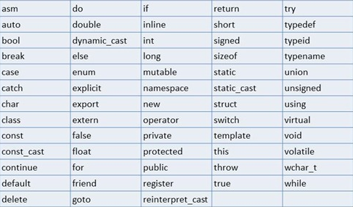
Reserved Keywords
Notes:
Src: C++ Primer Book

Slide 15
Identifier Naming Conventions
Use good names (sum, salary)
starts with lower letter
Multiple words use _ or upper letters
first_name or firstName.
Some people prefer include type in start
iNum => i for integer
bStatus => b for bool

Slide 16
Literal
Value 20 is called literal
We can write an integer literal in 3 ways. E.g. for value 20:
Decimal = 20
Octal = 024 (start with 0)
Hexadecimal = 0x14 (start with 0x)
Char literal: ‘b’
String Literal: “hello world”

Slide 17
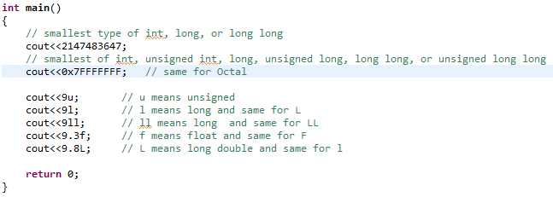
Literals with Suffix

Slide 18
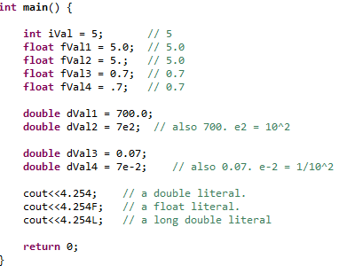
Floating Point Literals

Slide 19
Automatic Type Conversions
What if we used a type where we expect another?
bool status = age;
age is integer type, but we expect bool type!
Int age = salary
salary is double, but we expect integer type!
Type conversion converts one type to another
Also happens on operations:
double multiplication = age * salary;

Slide 20
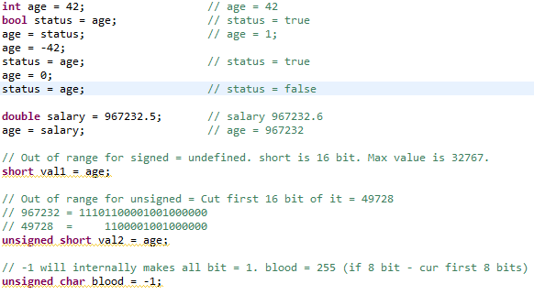
Type Conversions Examples

Slide 21
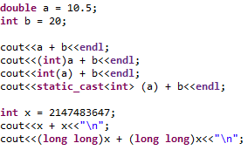

Forced Type Conversions
Forcing conversion is by casting in 3 ways:

Slide 22
Advise on data types
If values may be negative => signed
Use integer or long long (based on needs)
Use char/bool only when you need them
Use double, don’t use float. Usage only when fractions appear.
When declaring value, always initialize it.
int x; => BAD
int x = 0; => Good

Slide 23
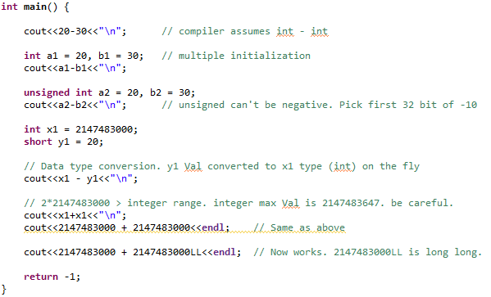

Guess Output

Slide 24
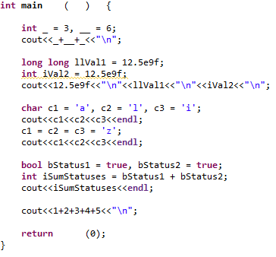

Guess Output

Slide 25
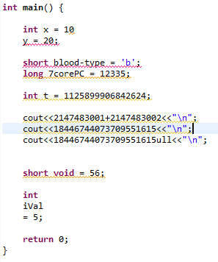
List all Errors and Warrings

Slide 26
At the end…
This is the first basics of C++ knowledge
Many students will find content weird.
If you understood it = ☺
If you don’t understand = Repeat twice.
If still, find other video on web + Read book.
Success key: Practice much.
Write all codes and play with them.

